Slide 1
PS Non-Standard Database Systems Stateful Stream Processor Apache Flink Group 12
Jeremias Peter Michael
Schranz Christoph
Zauner Martin

Slide 2
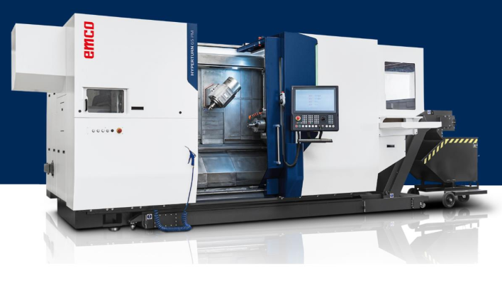
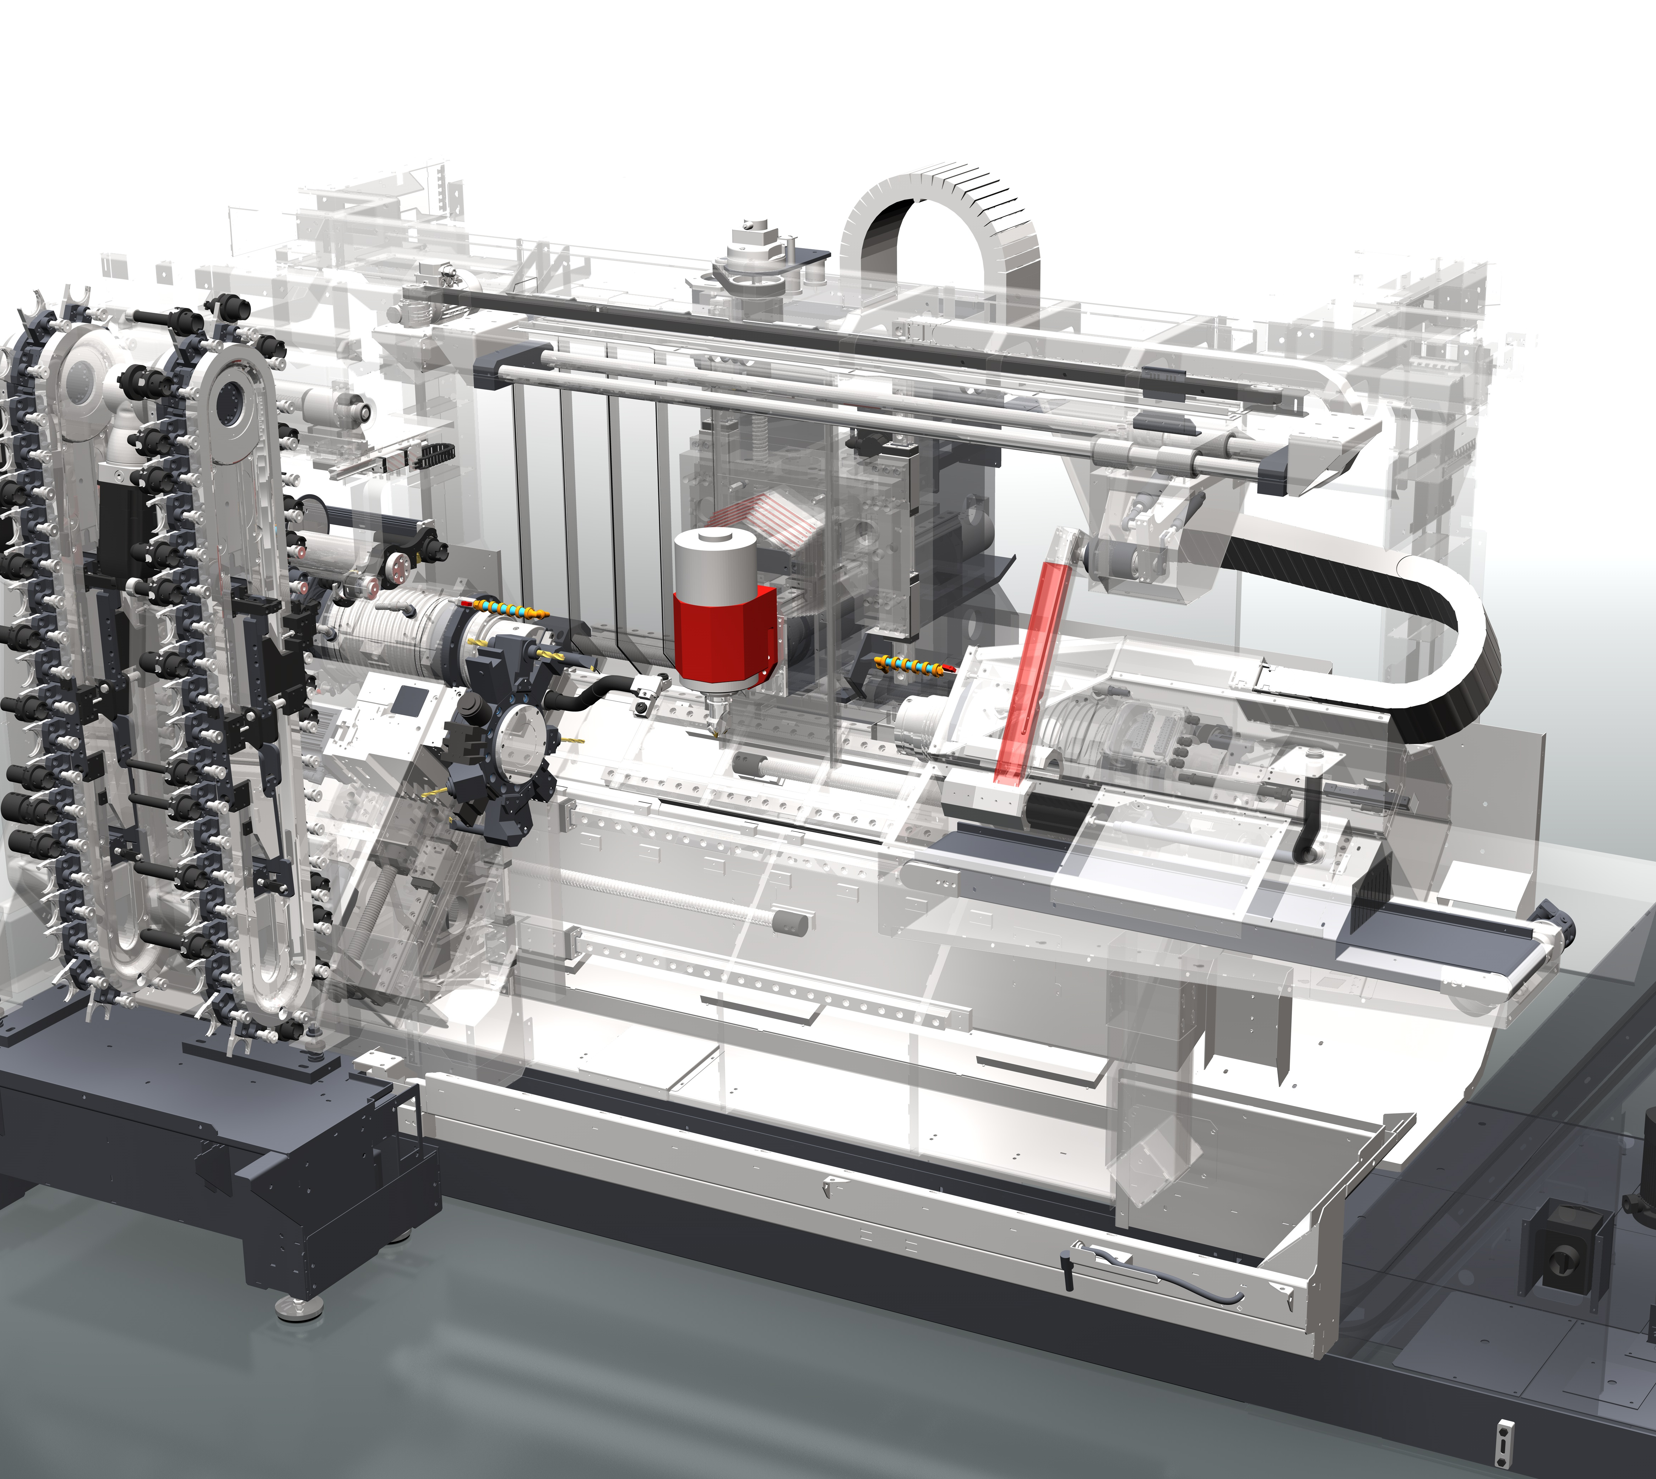
Introduction
Tool magazine
No. of cycles
Duration of cycles
…
Pneumatic
Pressure
Air consumption
Stroke rate
Switching cycles
Linear axes
Distance
Jerk
Friction, slip
Drive current
Temperatures
…
Automation
Function monitoring
Temperatures
Limit switches
…
Spindles
Operating hours
Speed
Vibrations
Drive current
Temperature
Fluid Technology
Pressure
Temperature
Volume flow
On duration of pump
Filling level
Filter monitoring
Chip conveyor
Operating hours
Power consumption

Slide 3

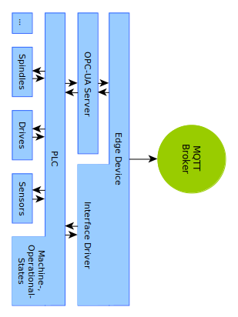
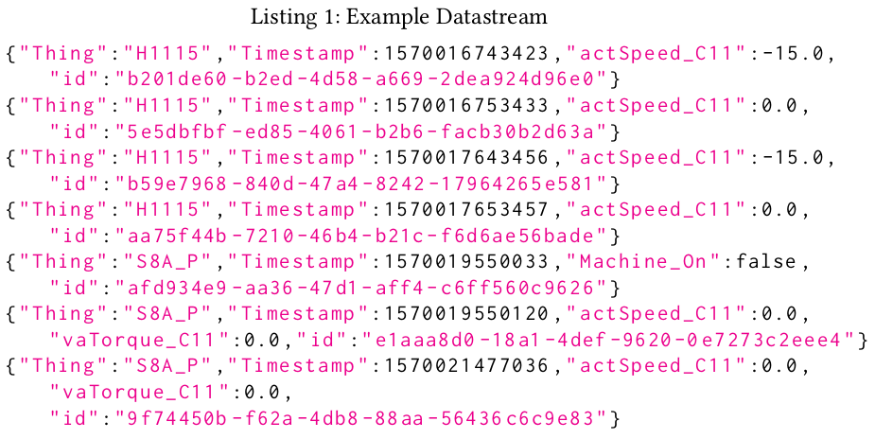
Data Generation, Data-Set
Edge Device polls for data
PLC requests data from component or returns data directly from memory
Edge Device sends the data to a MQTT-Broker
Each Data packet consists of one or many measurements

Slide 4
Data Generation, Data-Set
Delta threshold when transmitting data
=> Join data – forward-fill
Thing | Timestamp | actSpeed_C11 | vaTorque_C11
R9C15 | 1592739418131 | No data | -71.00
R9C15 | 1592739417131 | 0.00 | 19625.00
R9C15 | 1592739414134 | No data | -2571.00
R9C15 | 1592739413136 | No data | -6309.00
R9C15 | 1592739412136 | No data | -2711.00
R9C15 | 1592739411138 | No data | -5047.00
R9C15 | 1592739408142 | No data | -2103.00
R9C15 | 1592739407141 | -200.00 | 27.92
R9C15 | 1592739379162 | -400.04 | No data

Slide 5
Application Scenario
Reduce the data volume
Filter out windows of interest
Long term analysis: Eg. component wear (load equivalent)
Only aggregated data is stored
Short term analysis: Eg. detecting events (crashes, anomalies, alarms)
Collect extensive data for analytics

Slide 6
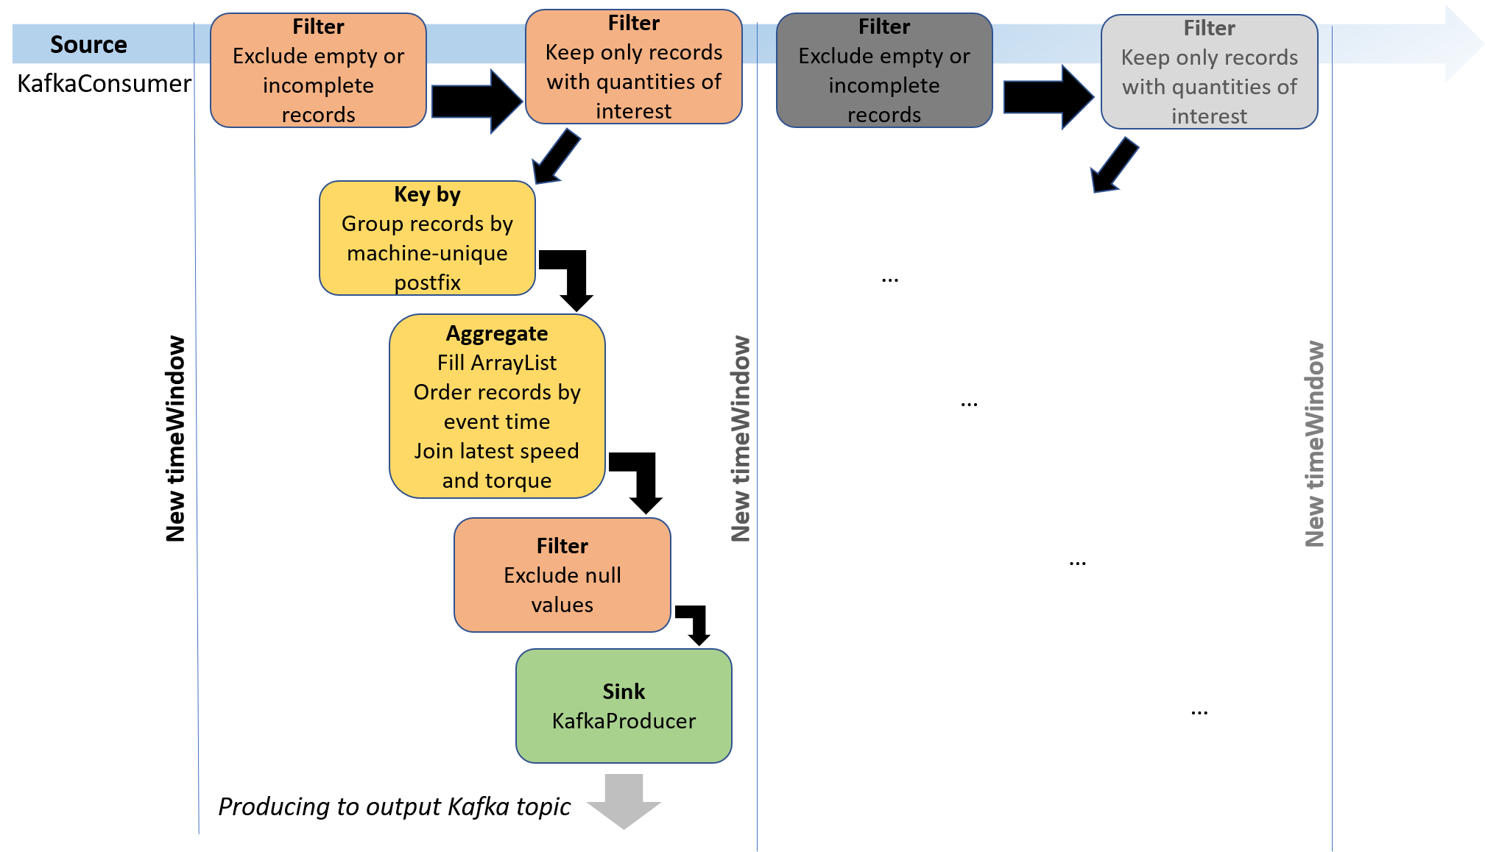
Reasons for Choosing the System
Complex filter conditions
State-fullness
Ordering of data -tuples by event-time
Exactly-once processing
Python API

Slide 7
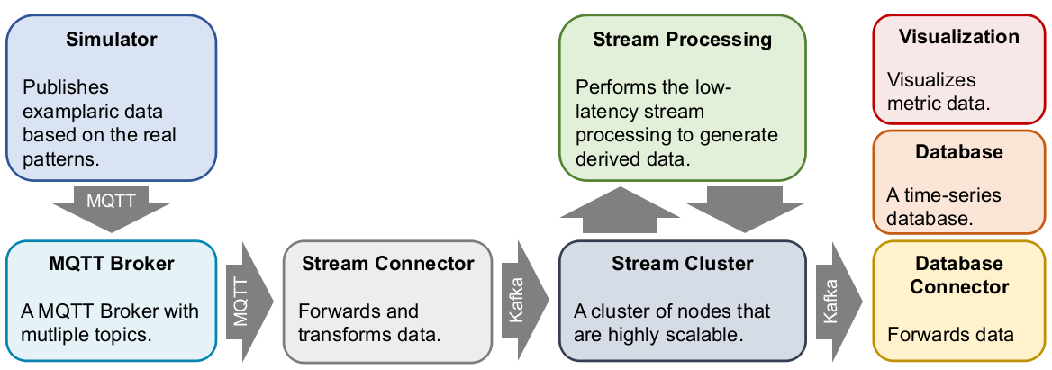
Setup
MQTT-Broker (Eclipse Mosquitto)
Stream Cluster (Apache Kafka, Apache Zookeeper,)
Stream Processing (Apache Flink) Cluster: Yarn, Mesos, Docker, Kubernetes
(Time-series) database (InfluxDB)
Visualization (Grafana)
Requirements: Java >= 8, Python 3.6
Ubuntu Linux 18.04

